Slide 1
RUSTikales Rust for advanced coders

Slide 2
Plan for today

Slide 3
Plan for today
Recap

Slide 4
Plan for today
Recap
tt-munchers

Slide 5
Plan for today
Recap
tt-munchers
Procedural Macros

Slide 6
Recap

Slide 7
Recap
Rust has a very powerful macro system

Slide 8
Recap
Rust has a very powerful macro system
Macros are useful for metaprogramming
They take Rust code as an input, and produce Rust code as an output

Slide 9
Recap
Rust has a very powerful macro system
Macros are useful for metaprogramming
They take Rust code as an input, and produce Rust code as an output
Declarative macros are declared using the keyword macro_rules!

Slide 10
Recap
Rust has a very powerful macro system
Macros are useful for metaprogramming
They take Rust code as an input, and produce Rust code as an output
Declarative macros are declared using the keyword macro_rules!
Declarative macros are expanded at compile time, in the parsing stage
Depending on the context, they are interpreted differently

Slide 11
Recap
Rust has a very powerful macro system
Macros are useful for metaprogramming
They take Rust code as an input, and produce Rust code as an output
Declarative macros are declared using the keyword macro_rules!
Declarative macros are expanded at compile time, in the parsing stage
macro_rules! matches AST nodes to metavariables, which we can use to implement logic

Slide 12
Recap
Rust has a very powerful macro system
Macros are useful for metaprogramming
They take Rust code as an input, and produce Rust code as an output
Declarative macros are declared using the keyword macro_rules!
Declarative macros are expanded at compile time, in the parsing stage
macro_rules! matches AST nodes to metavariables, which we can use to implement logic
ident matches an identifier
expr matches an expression
ty matches a type

Slide 13
Recap
Rust has a very powerful macro system
Macros are useful for metaprogramming
They take Rust code as an input, and produce Rust code as an output
Declarative macros are declared using the keyword macro_rules!
Declarative macros are expanded at compile time, in the parsing stage
macro_rules! matches AST nodes to metavariables, which we can use to implement logic
ident matches an identifier
expr matches an expression
ty matches a type
lifetime matches a lifetime
stmt matches a statement
pat matches a pattern

Slide 14
Recap
Rust has a very powerful macro system
Macros are useful for metaprogramming
They take Rust code as an input, and produce Rust code as an output
Declarative macros are declared using the keyword macro_rules!
Declarative macros are expanded at compile time, in the parsing stage
macro_rules! matches AST nodes to metavariables, which we can use to implement logic
ident matches an identifier
expr matches an expression
ty matches a type
lifetime matches a lifetime
stmt matches a statement
pat matches a pattern
tt matches any single tree node

Slide 15
Recap
Rust has a very powerful macro system
Macros are useful for metaprogramming
They take Rust code as an input, and produce Rust code as an output
Declarative macros are declared using the keyword macro_rules!
Declarative macros are expanded at compile time, in the parsing stage
macro_rules! matches AST nodes to metavariables, which we can use to implement logic
macro_rules! can also match repetitions of nodes
$($t:ty),* matches a comma-separated list of types

Slide 16
Recap
Rust has a very powerful macro system
Macros are useful for metaprogramming
They take Rust code as an input, and produce Rust code as an output
Declarative macros are declared using the keyword macro_rules!
Declarative macros are expanded at compile time, in the parsing stage
macro_rules! matches AST nodes to metavariables, which we can use to implement logic
macro_rules! can also match repetitions of nodes
The first matched rule is always chosen
Important when matching different types:
Every identifier is an expression
Not every expression is an identifier
Better to match identifiers first

Slide 17
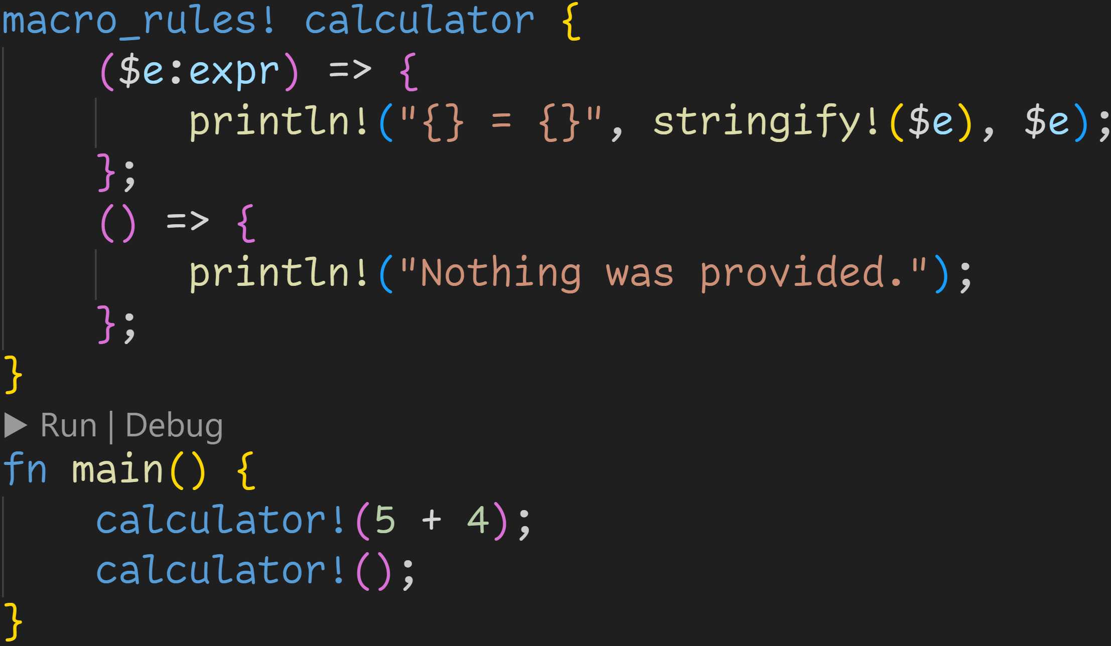
Recap

Slide 18
Recap
Name of the macro

Slide 19
Recap
Cases to match against

Slide 20
Recap
We expect an expression, which we bind to the metavariable $e

Slide 21
Recap
If we matched an expression, we insert this code at the macro call site

Slide 22
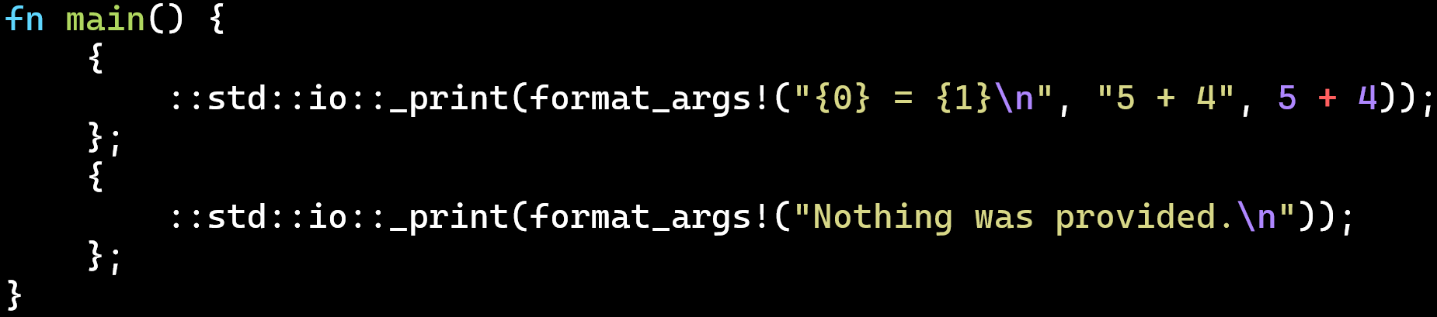
Using cargo expand we can see what the code looks like without macros
(cargo install cargo-expand)

Slide 23
Using cargo expand we can see what the code looks like without macros
(cargo install cargo-expand)
we matched an expression, and replaced it with the call to println!

Slide 24
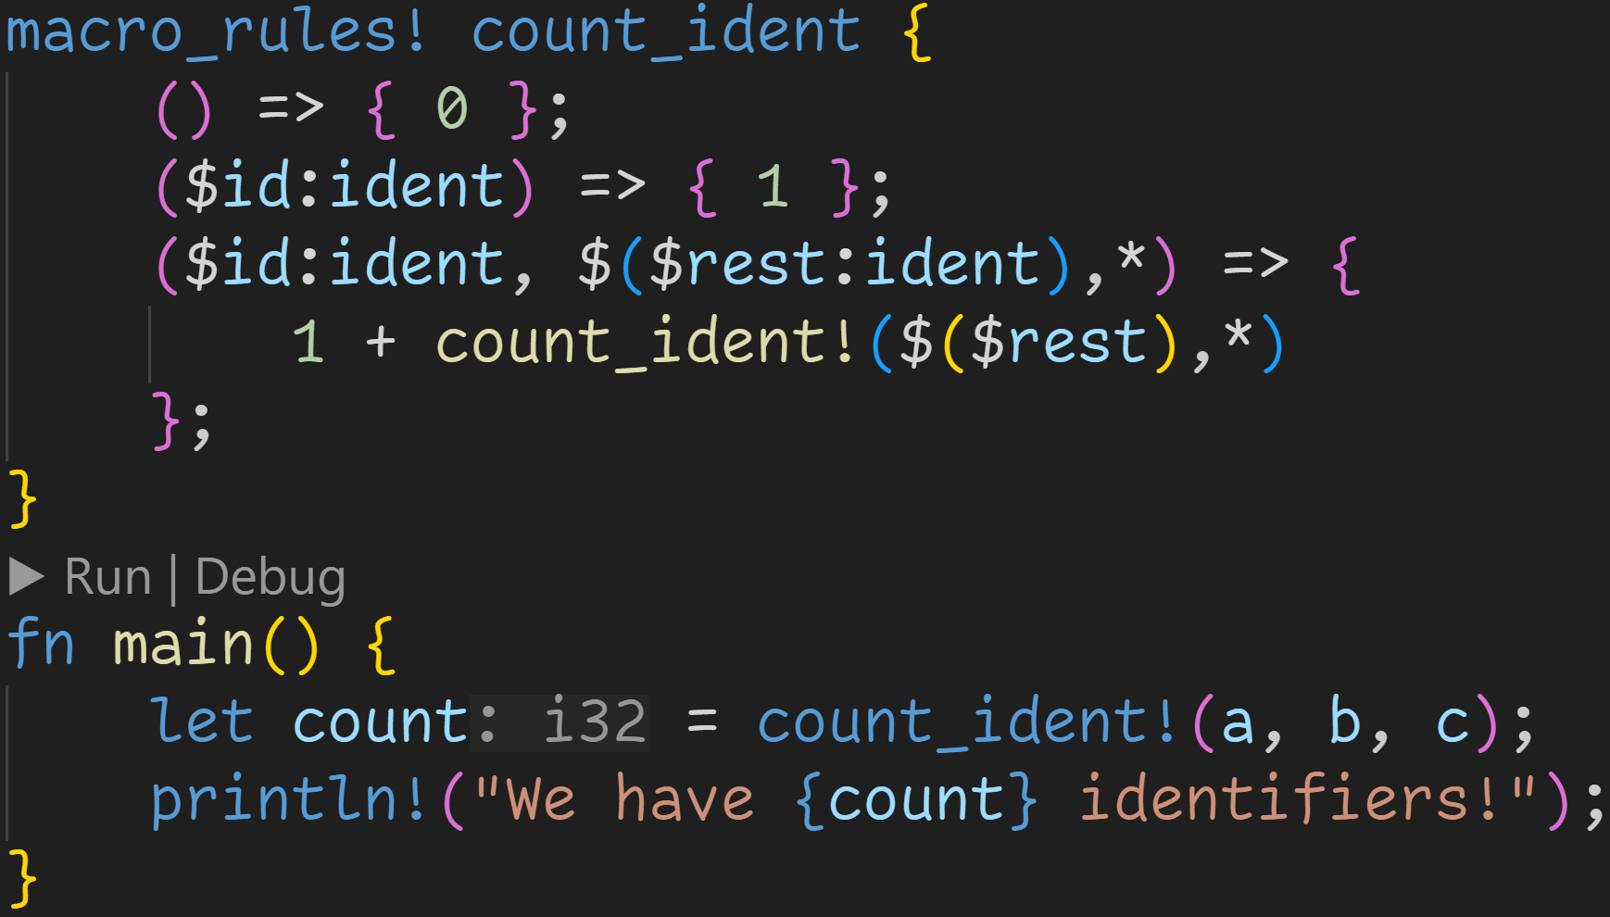

Slide 25
Macro invocations can be recursive
Here: Count all identifiers in the list

Slide 26
Macro invocations can be recursive
Here: Count all identifiers in the list
Idea: Split list into start and rest, and call macro again on the rest

Slide 27
We need some base cases to stop recursion

Slide 28
The order is not important, as rule 3 also expects a comma

Slide 29
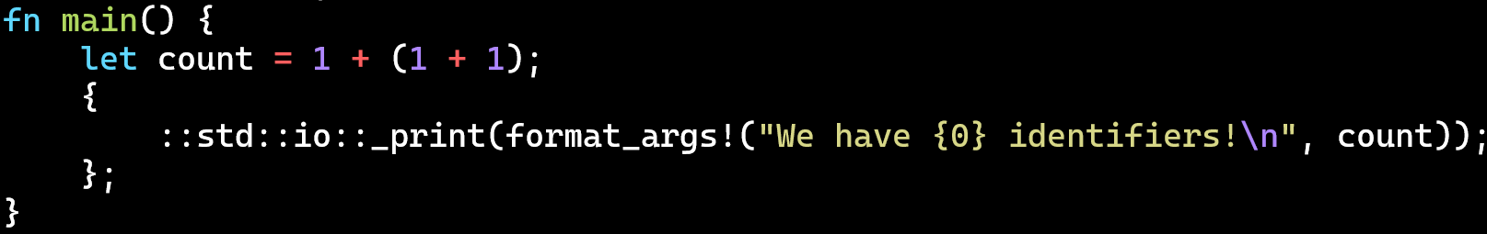

Slide 30
Important:
The count is computed at runtime!
We only generated the formula at compile time.

Slide 31
tt-munchers

Slide 32
tt-munchers
macro_rules! is very powerful and allows us to generate all sorts of code

Slide 33
tt-munchers
macro_rules! is very powerful and allows us to generate all sorts of code
Very often we encounter the same patterns when declaring macros

Slide 34
tt-munchers
macro_rules! is very powerful and allows us to generate all sorts of code
Very often we encounter the same patterns when declaring macros
To showcase one of the most important ones, we‘ll do something fancy today:
We‘ll implement a calculator for expressions in reverse polish notation using only macro_rules!

Slide 35
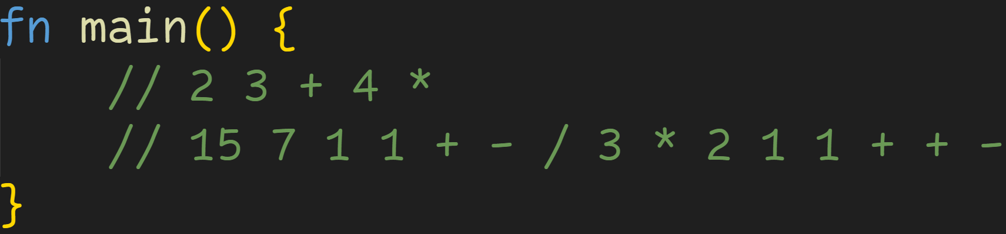
tt-munchers

Slide 36
tt-munchers
Stack

Slide 37
tt-munchers
Stack
2

Slide 38
tt-munchers
Stack
2
3

Slide 39
tt-munchers
Stack
2
3

Slide 40
tt-munchers
Stack
5

Slide 41
tt-munchers
Stack
5
4

Slide 42
tt-munchers
Stack
20

Slide 43
tt-munchers
macro_rules! is very powerful and allows us to generate all sorts of code
Very often we encounter the same patterns when declaring macros
To showcase one of the most important ones, we‘ll do something fancy today:
We‘ll implement a calculator for expressions in reverse polish notation using only macro_rules!
We‘ll start from the end, and slowly build it all up

Slide 44
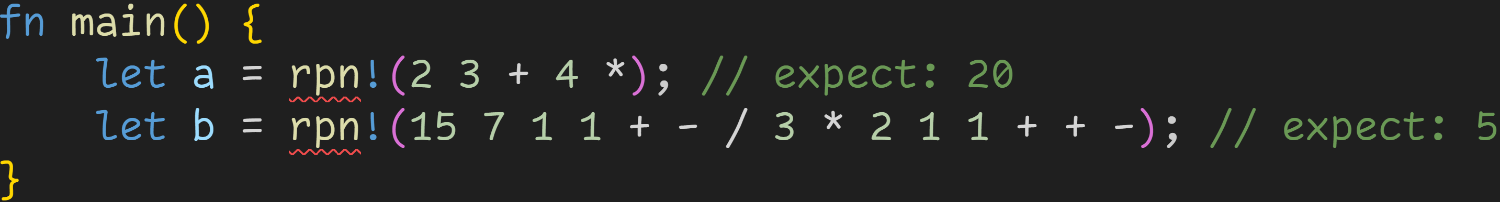
tt-munchers
We want our macro to return the result so we can freely use it later
(for example, to print it in the console)

Slide 45
tt-munchers
We want our macro to return the result so we can freely use it later
(for example, to print it in the console)
Let‘s start simple: Pushing a number to the stack

Slide 46
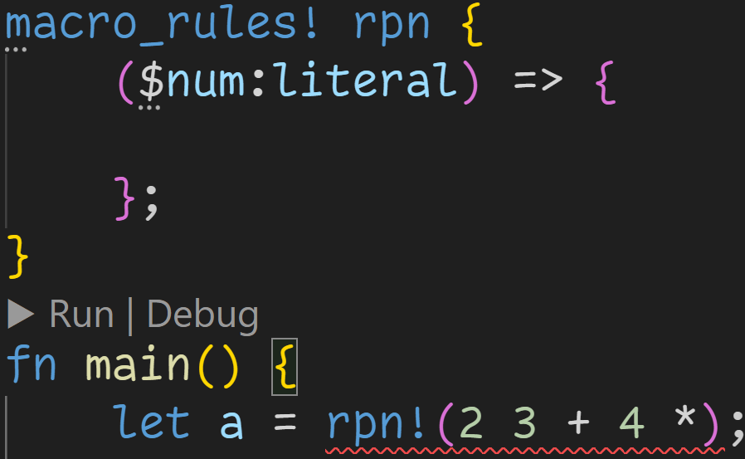
tt-munchers

Slide 47
tt-munchers
Matching a number is easy – We simply match a literal

Slide 48
tt-munchers
Matching a number is easy – We simply match a literal However, we also need a stack to keep track of all numbers

Slide 49
tt-munchers
Matching a number is easy – We simply match a literal However, we also need a stack to keep track of all numbers
→ Problem: Our macro can‘t use real variables, we need the stack at compile time

Slide 50
tt-munchers
Matching a number is easy – We simply match a literal However, we also need a stack to keep track of all numbers
→ Problem: Our macro can‘t use real variables, we need the stack at compile time → But we can work with token sequences

Slide 51
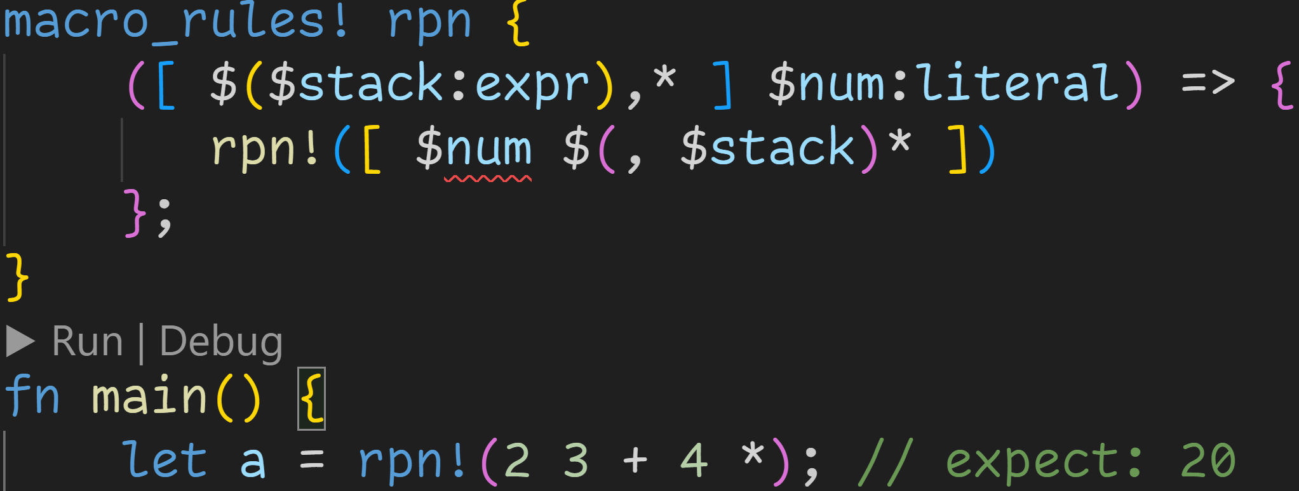
tt-munchers

Slide 52
tt-munchers
Idea: → The stack is a list of expressions

Slide 53
tt-munchers
Idea: → The stack is a list of expressions → Square brackets so we don‘t accidentally confuse it with input

Slide 54
tt-munchers
Idea: → The stack is a list of expressions → Square brackets so we don‘t accidentally confuse it with input → Elements in the stack are expressions such as 2 + 3

Slide 55
tt-munchers
Idea: → The stack is a list of expressions → Square brackets so we don‘t accidentally confuse it with input → Elements in the stack are expressions such as 2 + 3 → Later on we‘ll have rules to match operators against the stack

Slide 56
tt-munchers
There are no limits to what we can emit with macros → We can‘t directly modify the stack, but we can create a modified copy → Here: Push the number at the front

Slide 57
tt-munchers
The final code must be valid, but we‘re not actually generating anything!
The stack is only temporary and passed between macro calls.

Slide 58
tt-munchers
The final code must be valid, but we‘re not actually generating anything!
The stack is only temporary and passed between macro calls.
Okay, numbers are done! Now we need to work on the rest

Slide 59
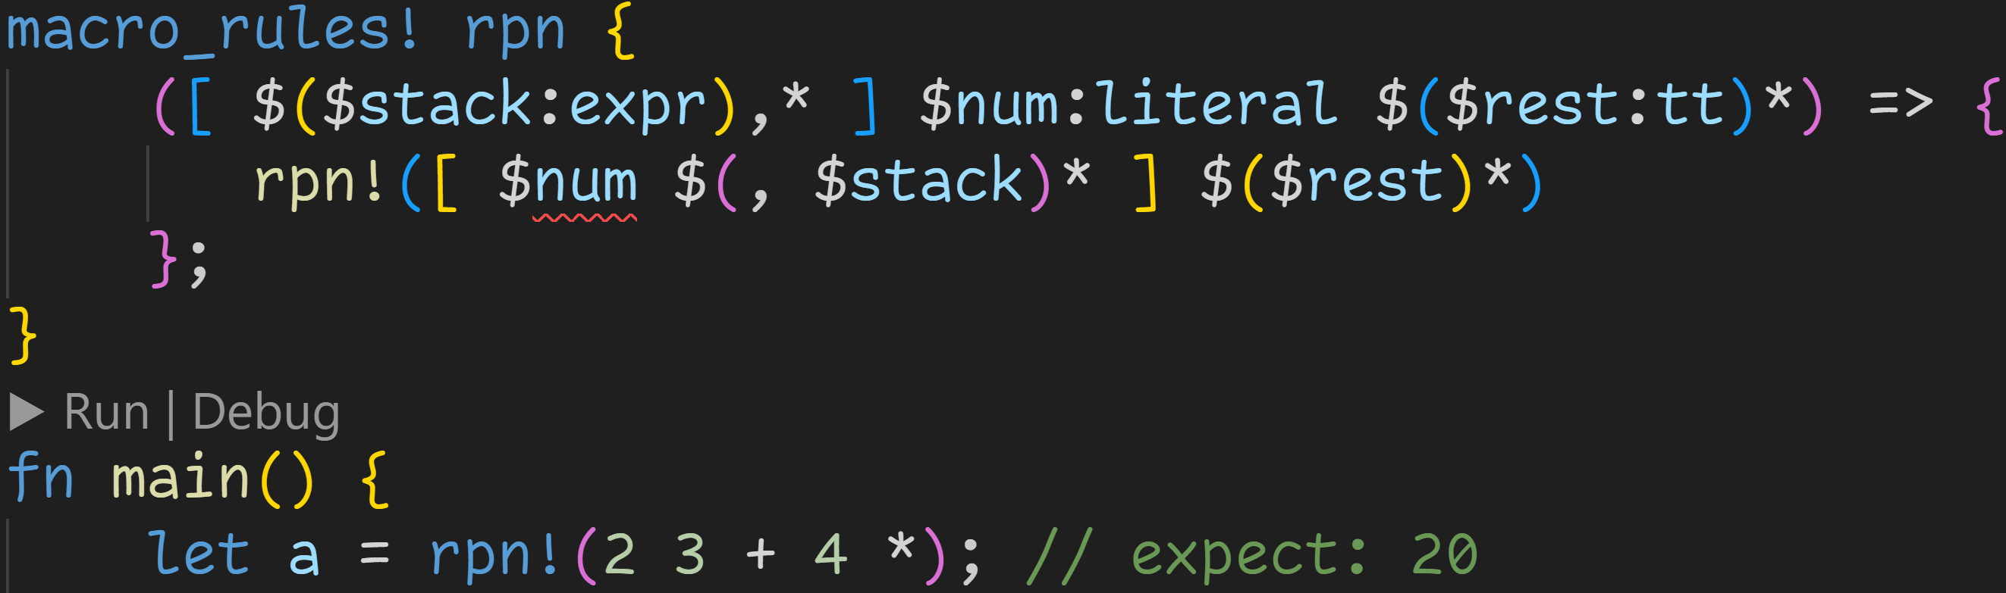
tt-munchers

Slide 60
tt-munchers
This is a tt-muncher – A pattern which comes up all the time with declarative macros

Slide 61
tt-munchers
This is a tt-muncher – A pattern which comes up all the time with declarative macros → We‘re processing one token at a time

Slide 62
tt-munchers
This is a tt-muncher – A pattern which comes up all the time with declarative macros → We‘re processing one token at a time, and pass along the rest

Slide 63
tt-munchers
This is a tt-muncher – A pattern which comes up all the time with declarative macros → We‘re processing one token at a time, and pass along the rest → We don‘t care what tree type the rest has, we eat it all

Slide 64
tt-munchers
This is a tt-muncher – A pattern which comes up all the time with declarative macros → We‘re processing one token at a time, and pass along the rest → We don‘t care what tree type the rest has, we eat it all
In our case: This macro now accepts a sequence of numbers, and puts them into the stack!

Slide 65
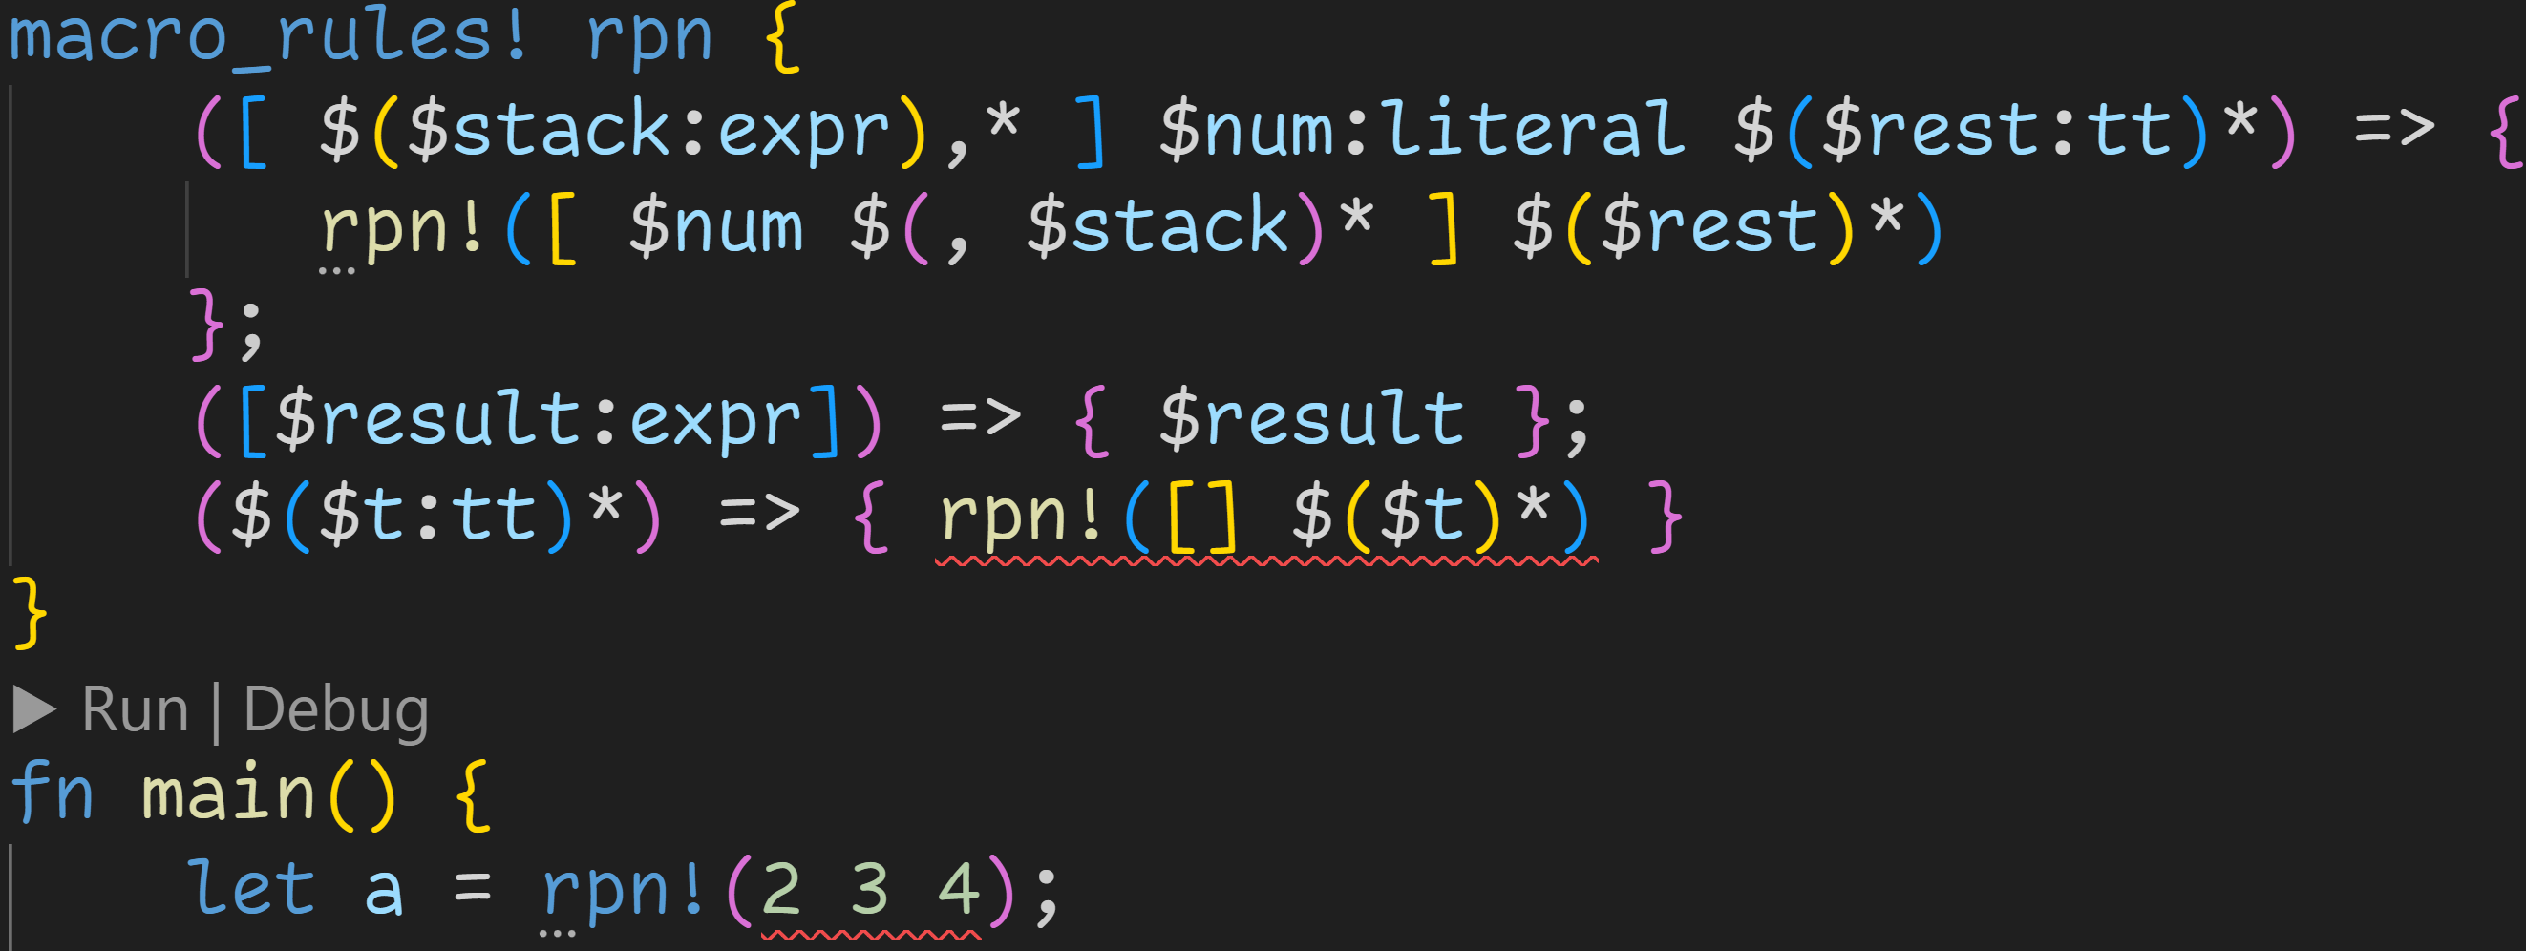
tt-munchers

Slide 66
tt-munchers
Our final result should be the only element

Slide 67
tt-munchers
Entrypoint so we don‘t have to specify []

Slide 68
tt-munchers
The compiler is not happy...

Slide 69
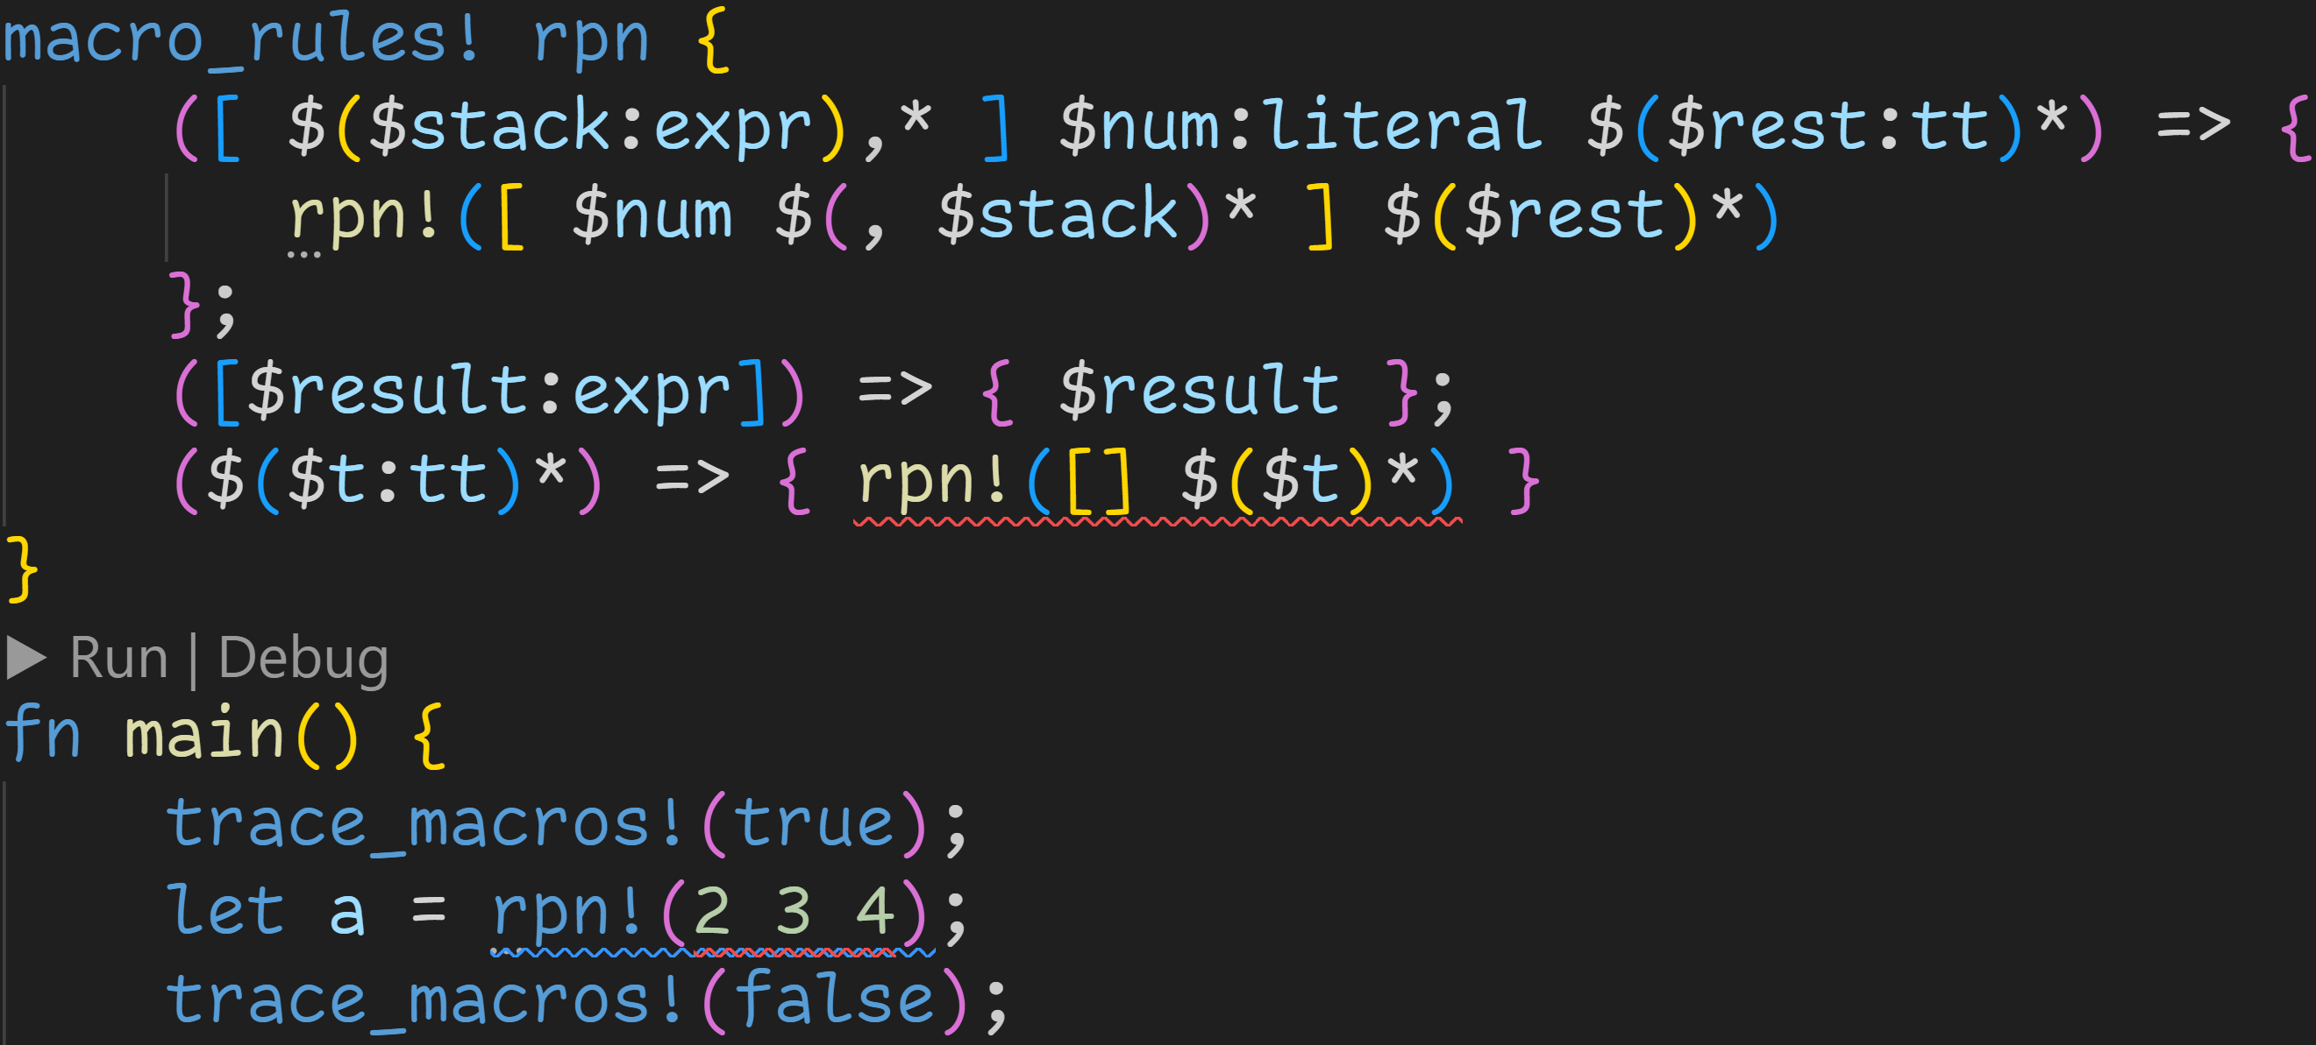
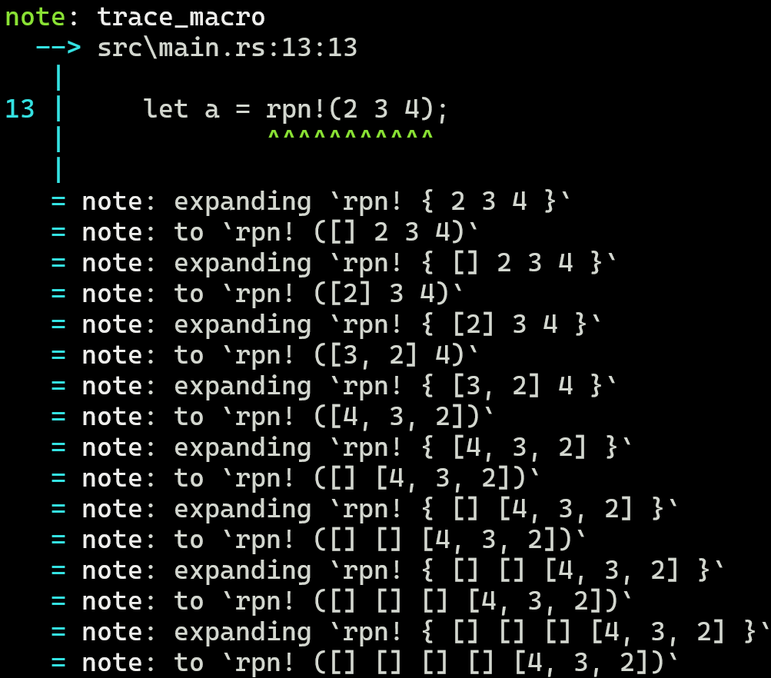

Slide 70
The important bit first: We collected the numbers into the stack!

Slide 71
The important bit first: We collected the numbers into the stack!
This is where it went wrong though...

Slide 72
The important bit first: We collected the numbers into the stack!
This is where it went wrong though...
→ The stack does not match rule 1

Slide 73
The important bit first: We collected the numbers into the stack!
This is where it went wrong though...
→ The stack does not match rule 1 → The stack does not contain a single expression → not rule 2

Slide 74
The important bit first: We collected the numbers into the stack!
This is where it went wrong though...
→ The stack does not match rule 1 → The stack does not contain a single expression → not rule 2 Rule 3 is a black hole, it matches everything – including our stack

Slide 75
The important bit first: We collected the numbers into the stack!
This is where it went wrong though...
→ The stack does not match rule 1 → The stack does not contain a single expression → not rule 2 Rule 3 is a black hole, it matches everything – including our stack And now we‘re stuck in infinite recursion...

Slide 76
But that‘s okay for now. We just wanted to put numbers into the stack.
Let‘s continue with operators.

Slide 77
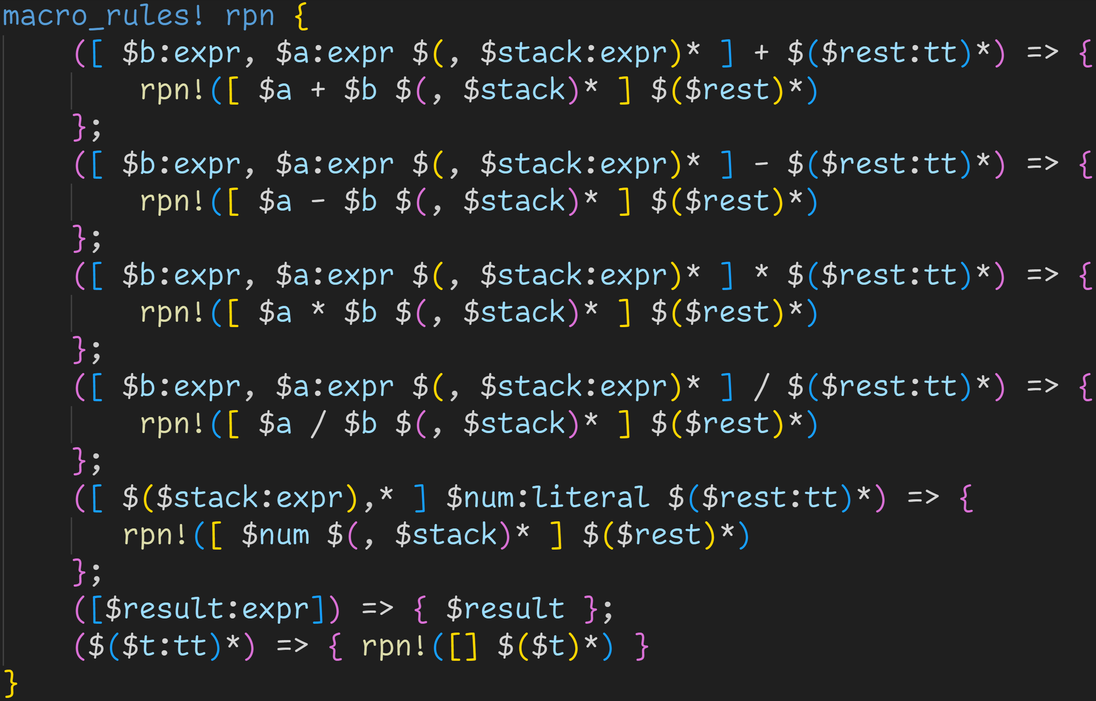

Slide 78
Sadly there is no operator-type, we need to match manually and write duplicate code

Slide 79
All operators expect 2 operands, which we explicitly match here → If the stack does not have two elements, we fall through

Slide 80
Then we push the result to the stack

Slide 81
The stack shrinks because we capture all but the first two elements

Slide 82
And finally, we proceed with eating tokens until we‘re done

Slide 83
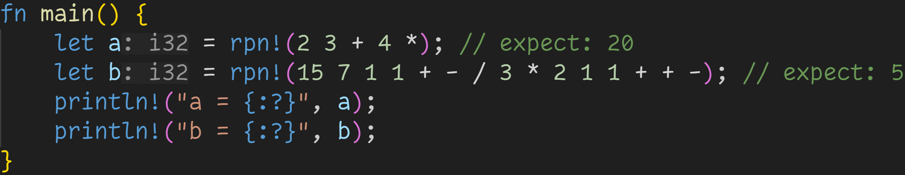
tt-munchers
We can now put the macro to the test!

Slide 84
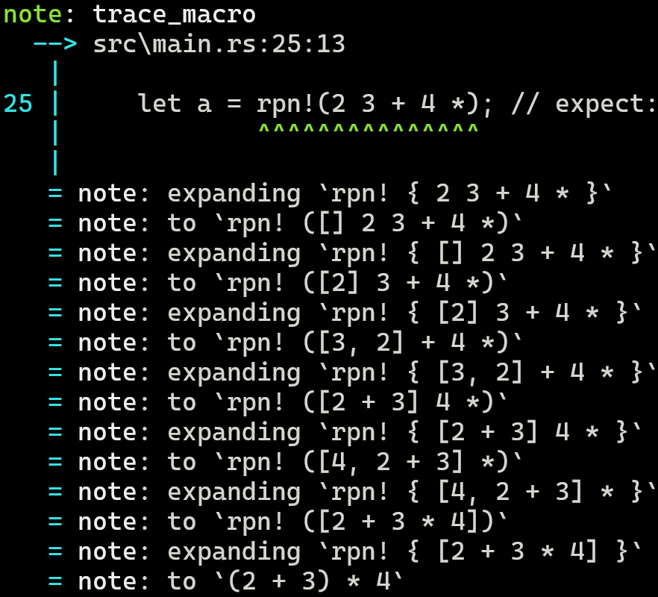

Slide 85
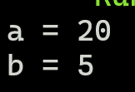

Slide 86
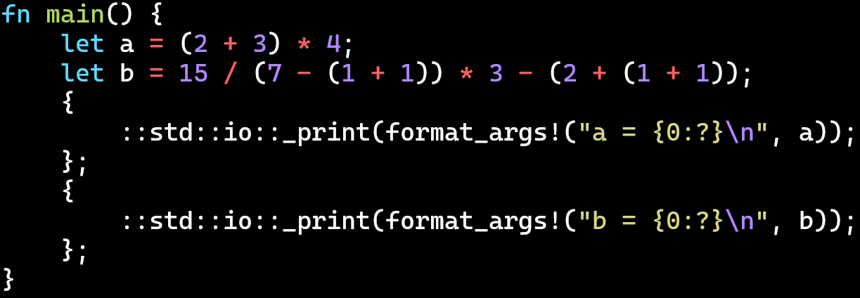
As expected, the macro properly evaluated the expression

Slide 87
2/3
The macro currently crashes for invalid expressions, for example if there aren‘t enough operands on the stack, or not enough operators in the equation → How could we fix that?

Slide 88
Procedural Macros

Slide 89
Procedural Macros
Procedural Macros are the second macro system that Rust offers

Slide 90
Procedural Macros
Procedural Macros are the second macro system that Rust offers
Procedural Macros operate over token streams instead of matching patterns at compile time

Slide 91
Procedural Macros
Procedural Macros are the second macro system that Rust offers
Procedural Macros operate over token streams instead of matching patterns at compile time
Procedural Macros are a special crate type in Rust, which you can use like any other library

Slide 92
Procedural Macros
Procedural Macros are the second macro system that Rust offers
Procedural Macros operate over token streams instead of matching patterns at compile time
Procedural Macros are a special crate type in Rust, which you can use like any other library
First, create a normal library

Slide 93
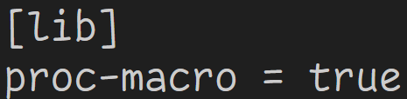
Procedural Macros
Procedural Macros are the second macro system that Rust offers
Procedural Macros operate over token streams instead of matching patterns at compile time
Procedural Macros are a special crate type in Rust, which you can use like any other library
First, create a normal library
lib.rs
Then declare it to be a proc-macro

Slide 94
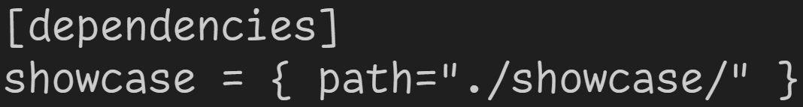
Procedural Macros
Procedural Macros are the second macro system that Rust offers
Procedural Macros operate over token streams instead of matching patterns at compile time
Procedural Macros are a special crate type in Rust, which you can use like any other library
First, create a normal library
lib.rs
Then declare it to be a proc-macro
Now you can use it like a normal library
main.rs

Slide 95
Procedural Macros
Procedural Macros are the second macro system that Rust offers
Procedural Macros operate over token streams instead of matching patterns at compile time
Procedural Macros are a special crate type in Rust, which you can use like any other library
Because of that, Procedural Macros are written in normal Rust, which makes them more flexible than macro_rules!

Slide 96
Procedural Macros
Procedural Macros are the second macro system that Rust offers
Procedural Macros operate over token streams instead of matching patterns at compile time
Procedural Macros are a special crate type in Rust, which you can use like any other library
Because of that, Procedural Macros are written in normal Rust, which makes them more flexible than macro_rules!
Procedural Macros are often used to generate complex code which macro_rules! isn‘t able to handle

Slide 97
Procedural Macros
Procedural Macros are the second macro system that Rust offers
Procedural Macros operate over token streams instead of matching patterns at compile time
Procedural Macros are a special crate type in Rust, which you can use like any other library
Because of that, Procedural Macros are written in normal Rust, which makes them more flexible than macro_rules!
Procedural Macros are often used to generate complex code which macro_rules! isn‘t able to handle
There are three types of Procedural Macros

Slide 98
Procedural Macros
Procedural Macros are the second macro system that Rust offers
Procedural Macros operate over token streams instead of matching patterns at compile time
Procedural Macros are a special crate type in Rust, which you can use like any other library
Because of that, Procedural Macros are written in normal Rust, which makes them more flexible than macro_rules!
Procedural Macros are often used to generate complex code which macro_rules! isn‘t able to handle
There are three types of Procedural Macros
Function-like macros – Just like declarative macros, invoked using macro_name!()

Slide 99
Procedural Macros
Procedural Macros are the second macro system that Rust offers
Procedural Macros operate over token streams instead of matching patterns at compile time
Procedural Macros are a special crate type in Rust, which you can use like any other library
Because of that, Procedural Macros are written in normal Rust, which makes them more flexible than macro_rules!
Procedural Macros are often used to generate complex code which macro_rules! isn‘t able to handle
There are three types of Procedural Macros
Function-like macros – Just like declarative macros, invoked using macro_name!()
Derive macros – Reduces boilerplate, used to implement traits for structs and enums

Slide 100
Procedural Macros
Procedural Macros are the second macro system that Rust offers
Procedural Macros operate over token streams instead of matching patterns at compile time
Procedural Macros are a special crate type in Rust, which you can use like any other library
Because of that, Procedural Macros are written in normal Rust, which makes them more flexible than macro_rules!
Procedural Macros are often used to generate complex code which macro_rules! isn‘t able to handle
There are three types of Procedural Macros
Function-like macros – Just like declarative macros, invoked using macro_name!()
Derive macros – Reduces boilerplate, used to implement traits for structs and enums
Attribute macros – Allows us to define outer attributes, which we can attach to items

Slide 101
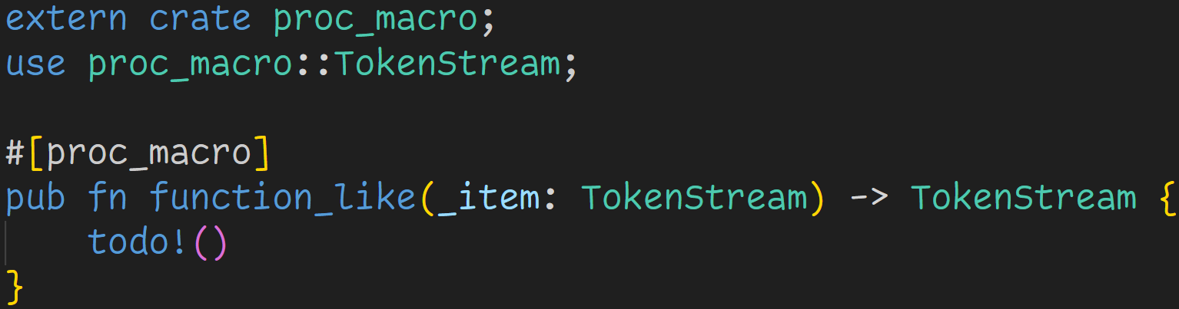
Procedural Macros – proc_macro
lib.rs

Slide 102
Procedural Macros – proc_macro
lib.rs
Procedural macros are normal functions

Slide 103
Procedural Macros – proc_macro
lib.rs
Procedural macros are normal functions
The attribute in front declares the type of the macro: proc_macro → Function-like macro proc_macro_derive → Derive macro proc_macro_attribute → Attribute macro

Slide 104
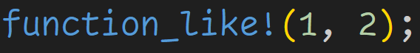
Procedural Macros – proc_macro
lib.rs
proc_macros are used like this:

Slide 105
Procedural Macros – proc_macro
lib.rs
Each type comes with a function signature that needs to be satisfied
Here: → proc_macro requires one argument of type TokenStream → proc_macro requires us to return a value of type TokenStream

Slide 106
Procedural Macros – proc_macro
lib.rs
Each type comes with a function signature that needs to be satisfied
Here: → proc_macro requires one argument of type TokenStream → proc_macro requires us to return a value of type TokenStream If the signature doesn‘t match, the library will not compile.

Slide 107
Procedural Macros – proc_macro
lib.rs
Procedural Macros don‘t work with tree nodes, they work with a TokenStream

Slide 108
Procedural Macros – proc_macro
lib.rs
TokenStream is a type defined in the crate proc_macro, which is part of the standard library, no third-party libraries required

Slide 109
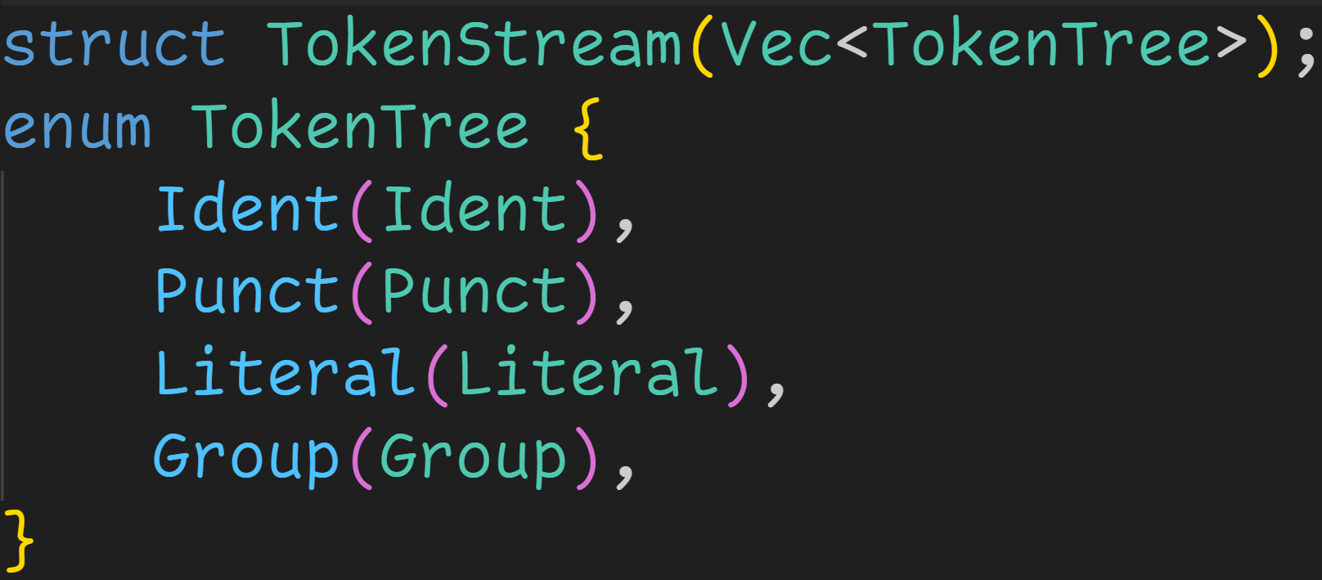
Procedural Macros – proc_macro

Slide 110
Procedural Macros – proc_macro
The final TokenStream we receive (and must return) is a sequence of TokenTrees, or a sequence of tokens

Slide 111
Procedural Macros – proc_macro
Fundamental tokens in Rust: → Ident: Identifiers and keywords → Punct: Single characters such as + or –
→ Literal: “Hello“, ‘a‘, 123u16

Slide 112
Procedural Macros – proc_macro
TokenStream which is surrounded by delimiters → Delimiter = () {} [] → (4 + 5) → { let x = 0; }

Slide 113
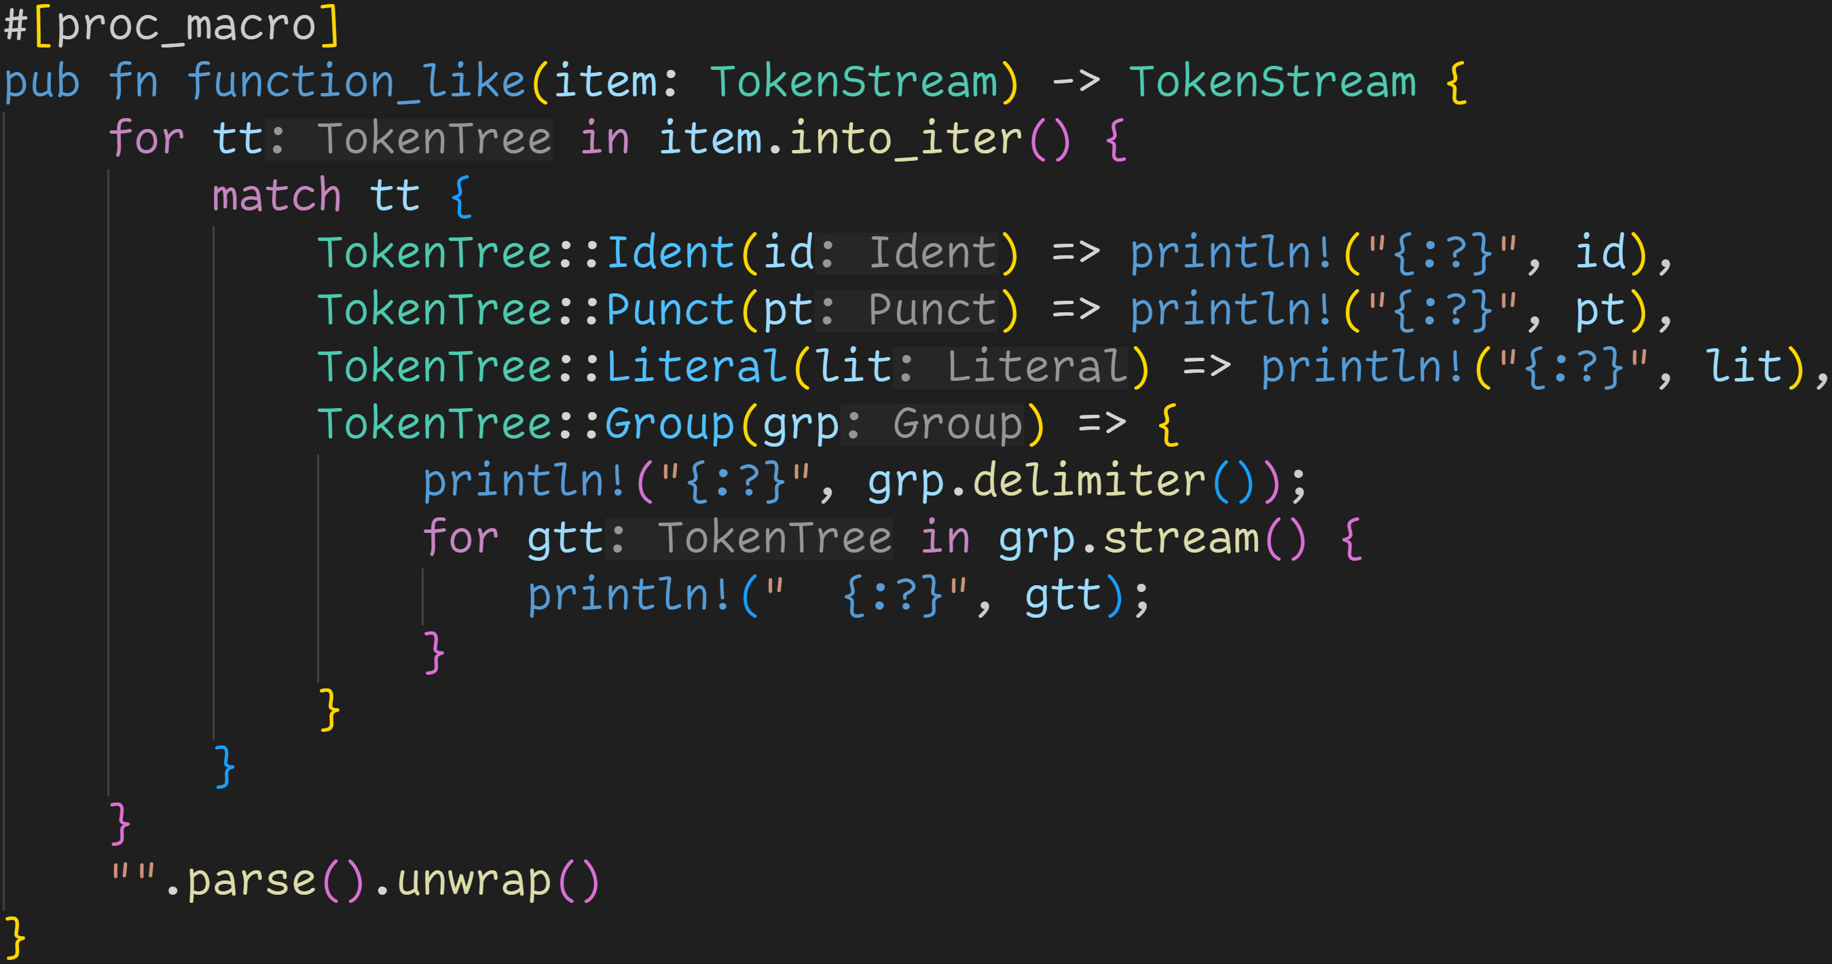
lib.rs

Slide 114
lib.rs
We can now write normal Rust code, and work with the given TokenStream Here we just iterate over the stream, and print each entry

Slide 115
lib.rs
We can now write normal Rust code, and work with the given TokenStream Here we just iterate over the stream, and print each entry and return nothing. This macro did not generate any code :^)

Slide 116
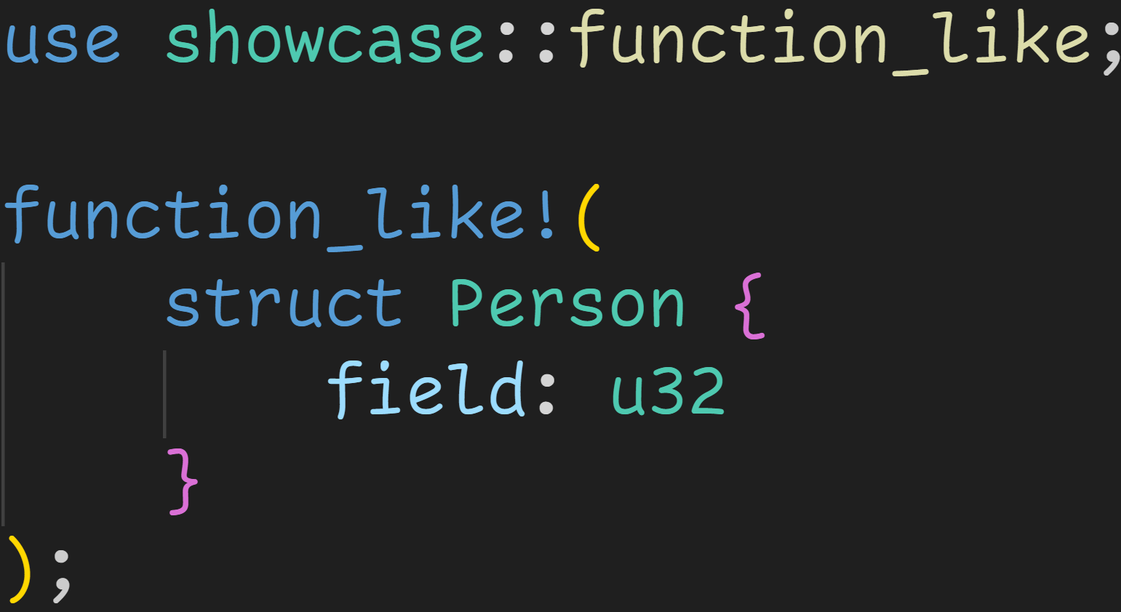
main.rs
lib.rs

Slide 117
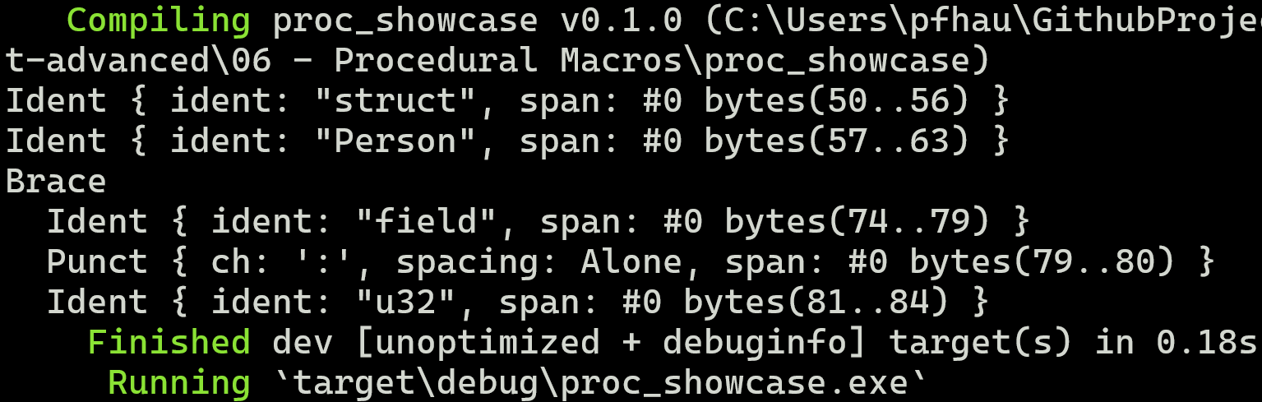
main.rs
lib.rs

Slide 118
main.rs
lib.rs
Procedural macros are called at compile time

Slide 119
Function-like macros capture everything between the brackets
main.rs
lib.rs

Slide 120
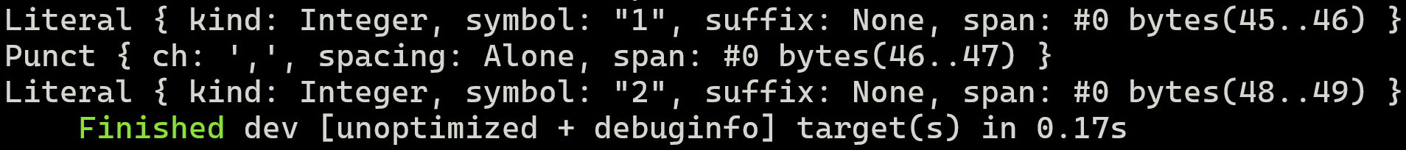
For multiple arguments, we still get a single TokenStream
lib.rs

Slide 121
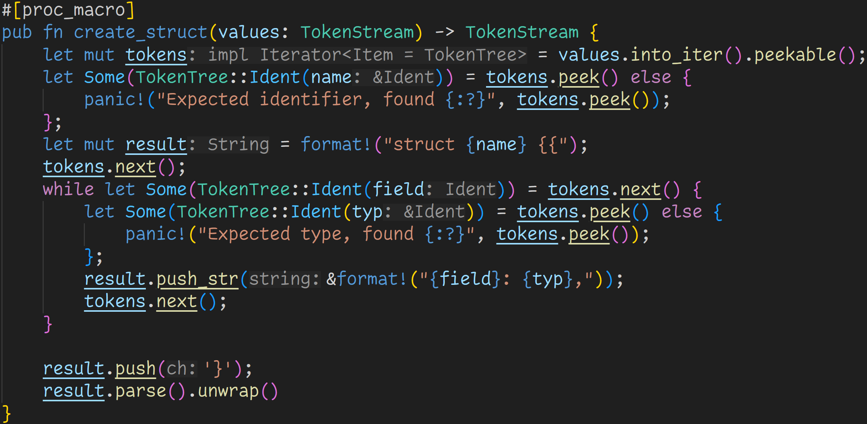
lib.rs

Slide 122
Usage:
lib.rs

Slide 123
Usage:
lib.rs
Turn TokenStream into iterator so we can work with it

Slide 124
Usage:
lib.rs
Expect name of the struct

Slide 125
Usage:
lib.rs
Panics in procedural macros are caught by the compiler, and turned into a normal compiler error

Slide 126
Usage:
lib.rs
We now generate code!

Slide 127
Usage:
lib.rs
While there are tokens, expect a pair of two identifiers every time

Slide 128
Usage:
lib.rs
We do not have information if this type is actually valid, that‘s the job of the Type Checker

Slide 129
Usage:
lib.rs
Add a new field to the struct!

Slide 130
Usage:
lib.rs
Close struct brackets

Slide 131
Usage:
lib.rs
parse() converts the String into a TokenStream due to type inference

Slide 132
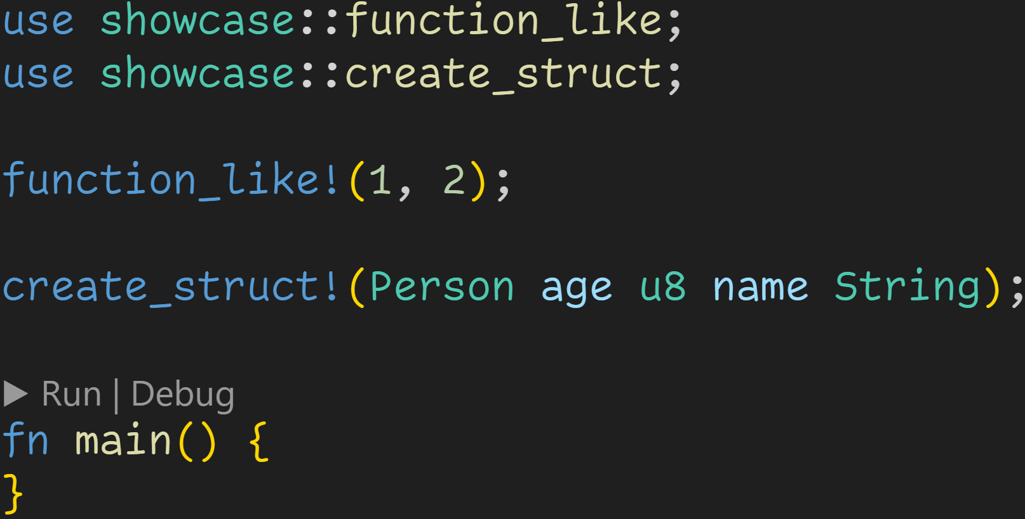
main.rs

Slide 133
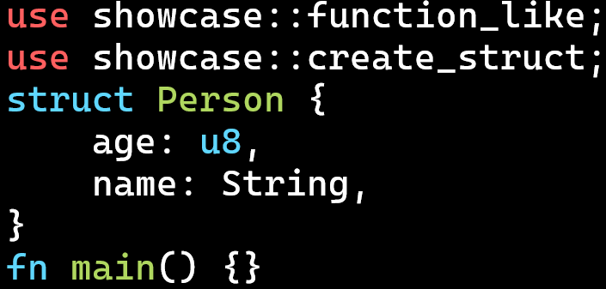
main.rs

Slide 134
main.rs
This macro always returns an empty stream

Slide 135
main.rs
We successfully generated a struct Person, which we can now use in our code!

Slide 136
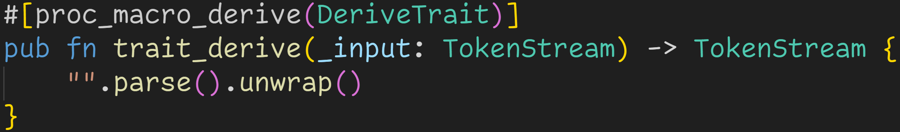
Procedural Macros – proc_macro_derive

Slide 137
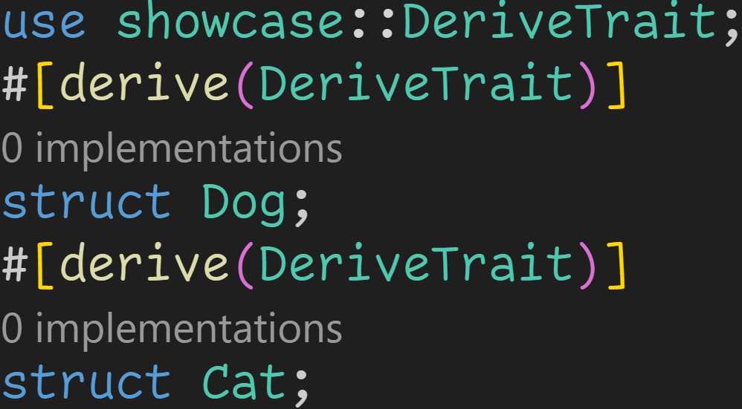
Procedural Macros – proc_macro_derive
proc_macro_derives are used like this:

Slide 138
Procedural Macros – proc_macro_derive
proc_macro_derives are used like this:
calls our macro in the background

Slide 139
Procedural Macros – proc_macro_derive
proc_macro_derive accepts one argument, and returns a TokenStream

Slide 140
Procedural Macros – proc_macro_derive
proc_macro_derive accepts one argument, and returns a TokenStream
Important:
proc_macro and proc_macro_attribute eat the input, proc_macro_derive leaves it untouched! The input is the struct/enum you want to derive the trait for.

Slide 141
Procedural Macros – proc_macro_derive
The name here is not the trait you derive, it‘s what you later call #[derive()] with → DeriveTrait → #[derive(DeriveTrait)] → ABC → #[derive(ABC)]

Slide 142
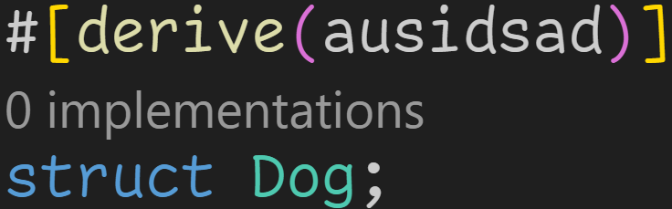
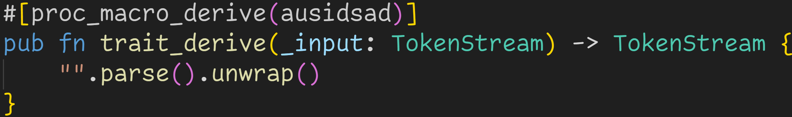
Procedural Macros – proc_macro_derive
You can name it whatever you want

Slide 143
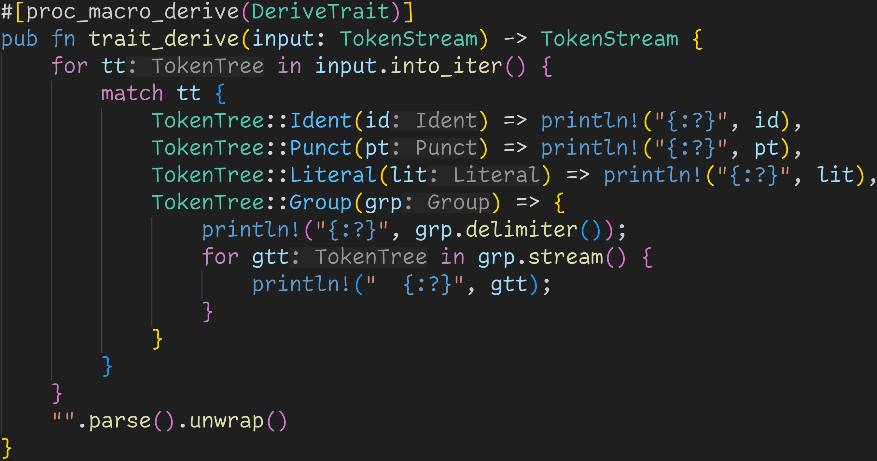
Procedural Macros – proc_macro_derive
lib.rs
main.rs

Slide 144
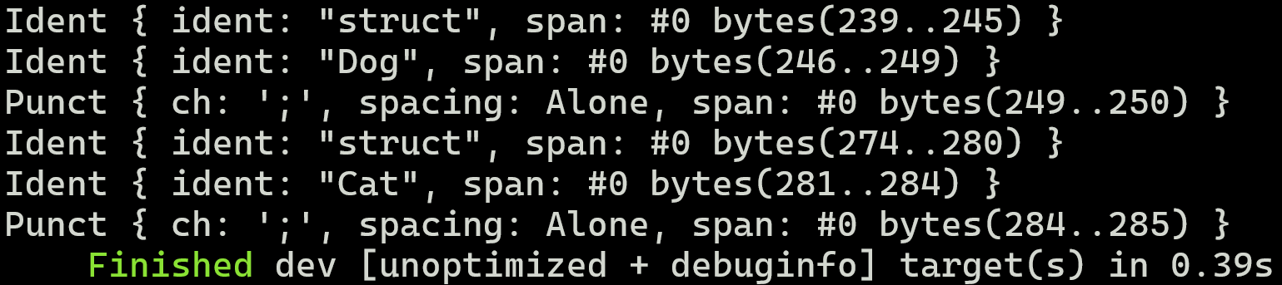
lib.rs
main.rs

Slide 145
lib.rs
Derive macros capture the item after the derive invocation
main.rs

Slide 146
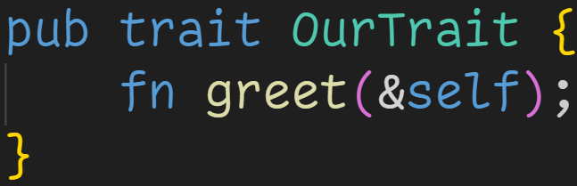
The trait we‘re deriving:

Slide 147
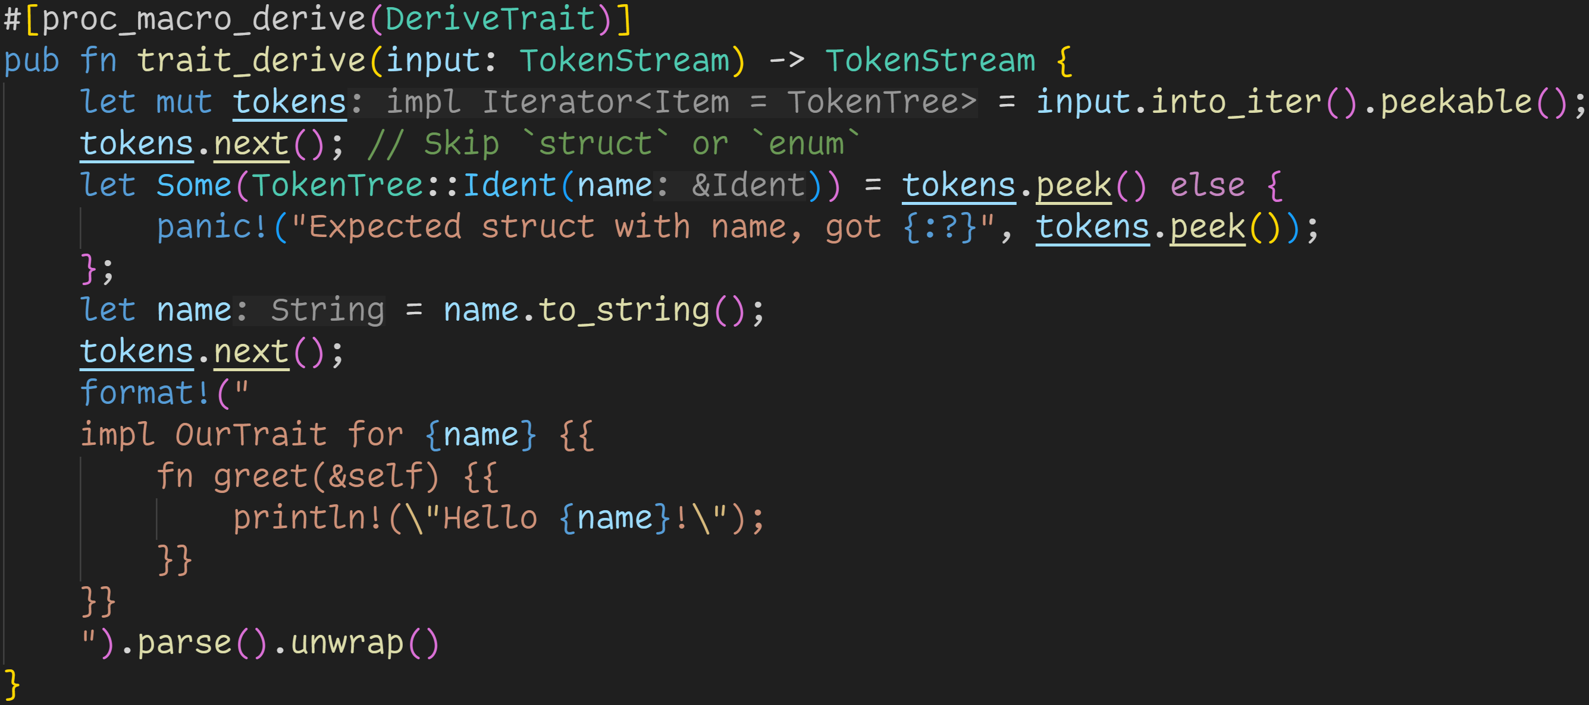
The trait we‘re deriving:

Slide 148
The trait we‘re deriving:
Get struct/enum name

Slide 149
The trait we‘re deriving:
Here we generate and return the trait implementation, where we greet the type

Slide 150
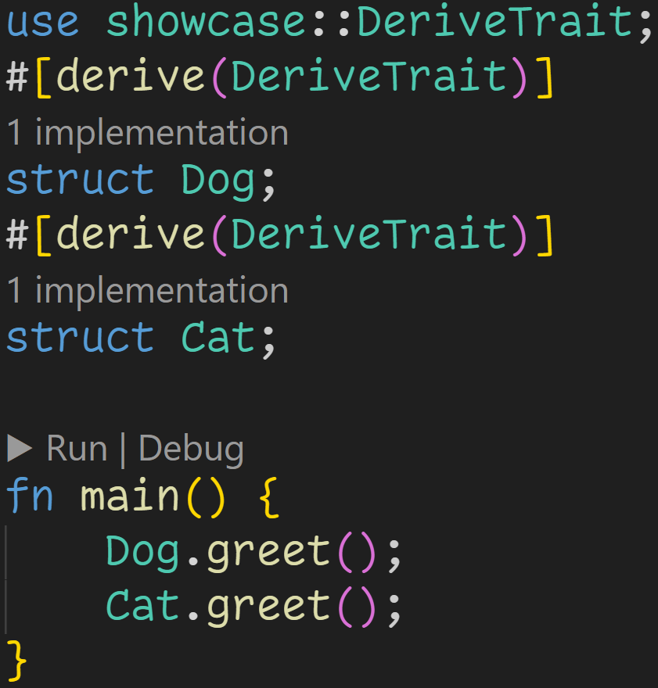
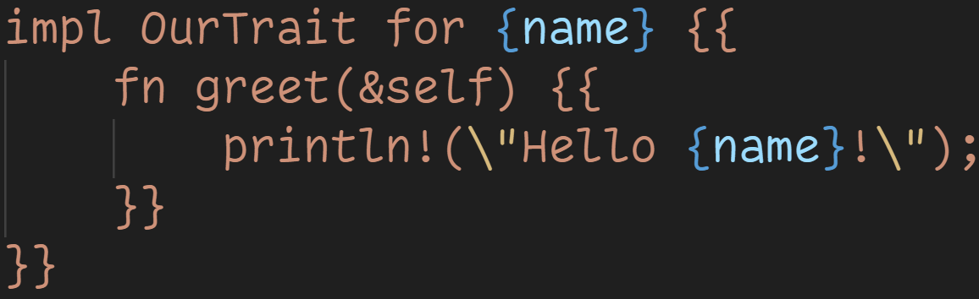

Slide 151
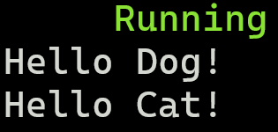

Slide 152
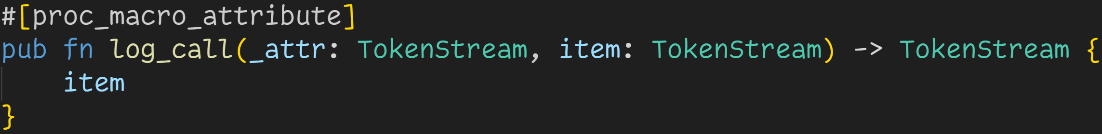
Procedural Macros – proc_macro_attribute

Slide 153
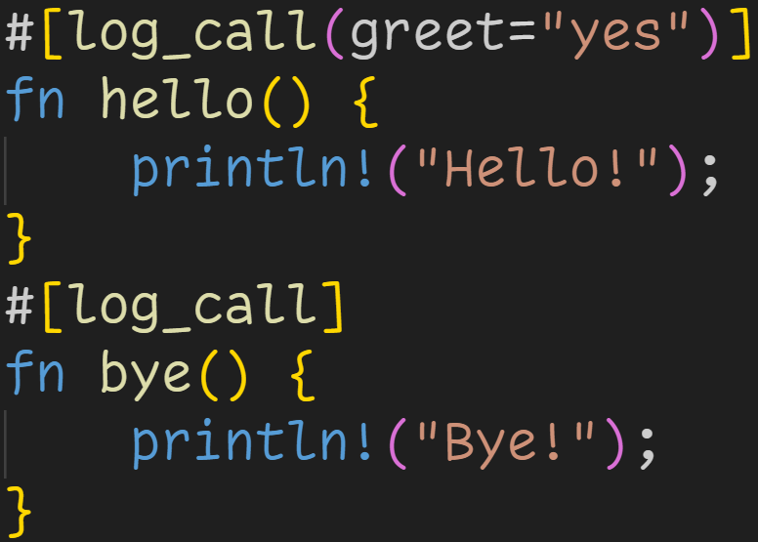
Procedural Macros – proc_macro_attribute
proc_macro_attributes are used like this:

Slide 154
Procedural Macros – proc_macro_attribute
proc_macro_attributes are used like this:
Calls our macro in the background

Slide 155
Procedural Macros – proc_macro_attribute
Attribute Macros are different: They expect two arguments → The first argument is the token tree following the attribute‘s name → The second argument is the rest of the item, including other attributes

Slide 156
Procedural Macros – proc_macro_attribute

Slide 157
Procedural Macros – proc_macro_attribute
Attribute stream is empty here

Slide 158
Procedural Macros – proc_macro_attribute
Attribute stream is empty here

Slide 159
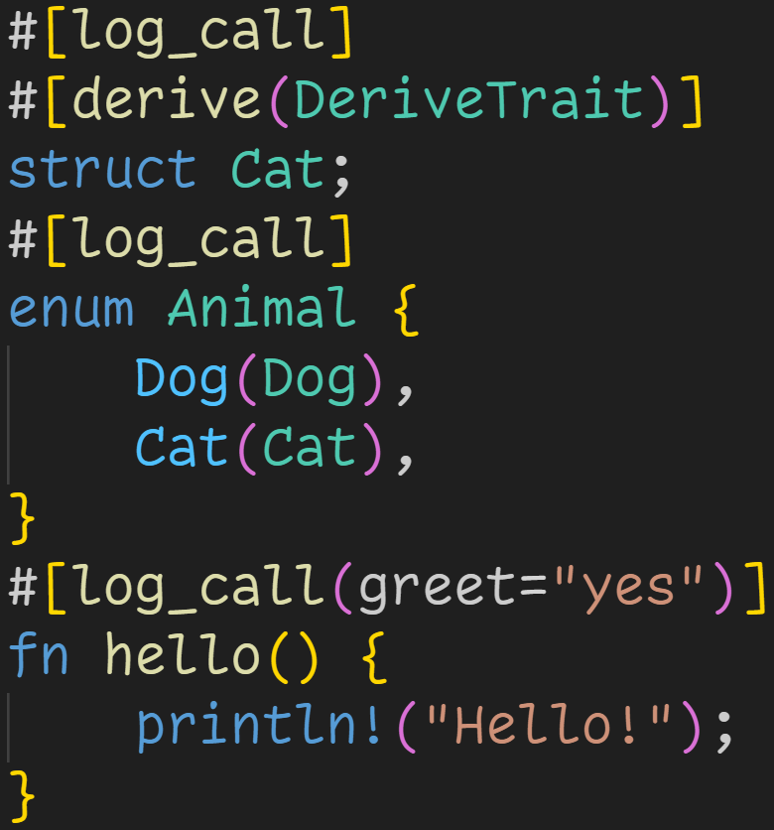
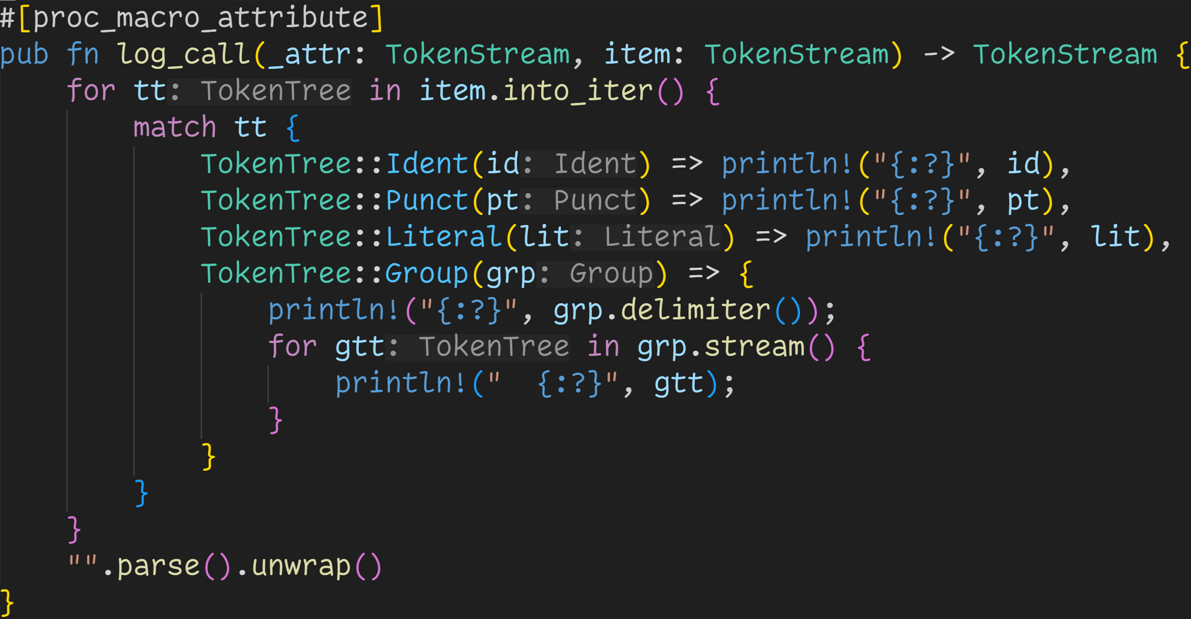
main.rs
lib.rs

Slide 160
main.rs
lib.rs
Many items accept attributes

Slide 161
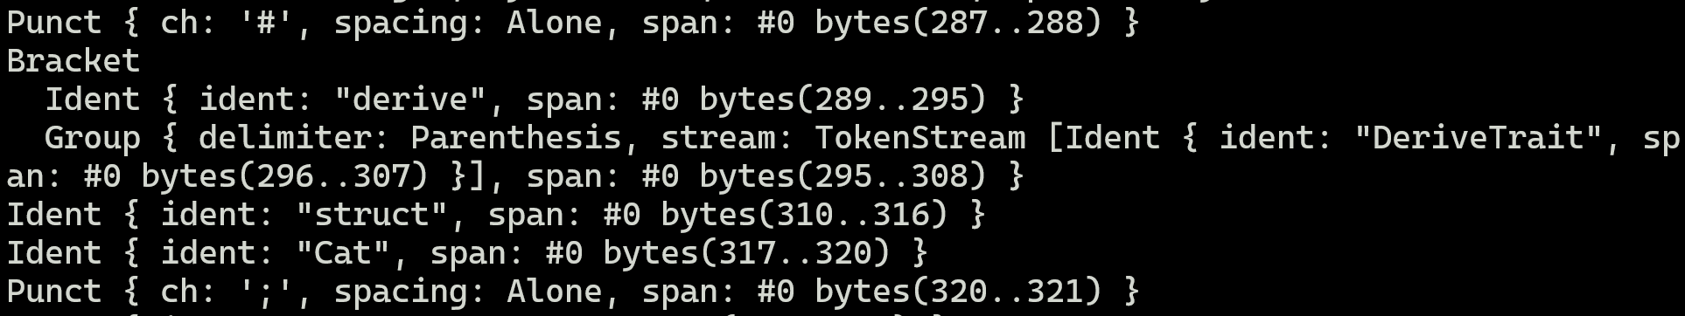
Procedural Macros – proc_macro_attribute

Slide 162
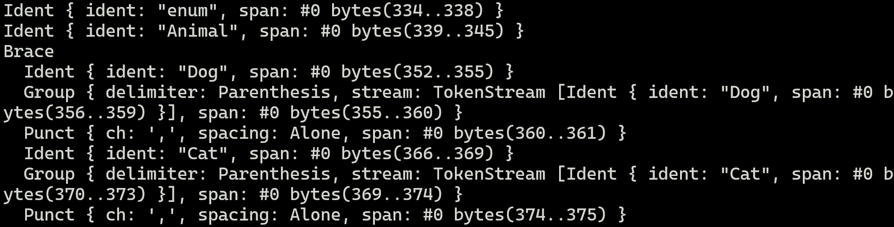
Procedural Macros – proc_macro_attribute

Slide 163
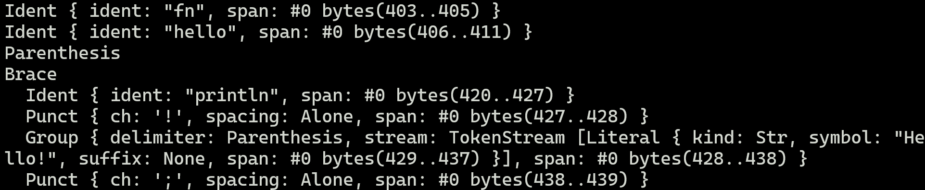
Procedural Macros – proc_macro_attribute

Slide 164
Procedural Macros – proc_macro_attribute
We can call procedural macros in many different contexts

Slide 165
Procedural Macros – proc_macro_attribute
We can call procedural macros in many different contexts
We need to make sure that the macro is always correct, for any input

Slide 166
Procedural Macros – proc_macro_attribute
We can call procedural macros in many different contexts
We need to make sure that the macro is always correct, for any input
That‘s a lot of complexity, given that we‘re only working with token streams

Slide 167
Procedural Macros – proc_macro_attribute
We can call procedural macros in many different contexts
We need to make sure that the macro is always correct, for any input
That‘s a lot of complexity, given that we‘re only working with token streams
But: Because we‘re using normal Rust, we can use everything that Rust provides

Slide 168
Procedural Macros – proc_macro_attribute
We can call procedural macros in many different contexts
We need to make sure that the macro is always correct, for any input
That‘s a lot of complexity, given that we‘re only working with token streams
But: Because we‘re using normal Rust, we can use everything that Rust provides
We can use crates which parse streams into convenient structures, to make writing procedural macros easier

Slide 169
Procedural Macros – proc_macro_attribute
We can call procedural macros in many different contexts
We need to make sure that the macro is always correct, for any input
That‘s a lot of complexity, given that we‘re only working with token streams
But: Because we‘re using normal Rust, we can use everything that Rust provides
We can use crates which parse streams into convenient structures, to make writing procedural macros easier
The most important crates, syn and quote, will be introduced next week

Slide 170
Next time
syn + quote
Functional Programming in Rust

